Slide 1
Generalized Additive Model

Slide 2
Introduction to GAMs
GAMs is the addition of smooth functions of covariates and linear effects.
GAMs provides a tradeoff between the interpretability of linear models or generalized linear models and the flexibility of non parametric complex approaches like Neural networks or trees.
They can easily fit nonlinear functions to get predictions and obtain some inference about the model as well.
Data is fitted using smooth functions(made up from basis functions) or splines to accommodate for the nonlinearity in the relationship between variables.

Slide 3
GAMs in R
To work with GAMs in R the mgcv library was used
The model is fitted using the gam() function with the formula like that of LM or GLM. However; we introduce the s() smoothing function for the nonlinear covariate.
gams_model <- gam(response ~ s(nonlinear covariate 1)+ s(nonlinear covariate 2)+ linear covariate,
data = mydataset, family = E.F(link= “ "), )
Linear and non linear terms could be added.

Slide 4
Parameters in GAMs
This could be changed by changing the value of k defined for the smooth as follows: s(x1, k= no# of splines).
As k increases, the smooth fits the data more.
We can also change the smoothing parameter: sp, to balance between likelihood and wiggliness of the curve; hence, optimizing the model fit.
Increasing the smoothing parameter sp greatly will give us a linear effect.

Slide 5
How to interpret the GAMs results?
summary(model): we can determine which covariates are not statistically significant; thus removing them in the next fitted model.
plot(model, residuals= TRUE): to show residuals of smoothed functions vs. its covariate.
concurvity(): is the similar term to co-linearity in GLMs.
It occurs when a predictor could be represented as a smooth of another predictor.
The value ranges from 0 causing no problem to 1 indicating an issue.
Avoid putting multiple collinear variables in the same model.

Slide 6
How to interpret the GAMs results?
gam.check(model): to decide on which variables are already linear and does not need smoothing.
This is indicated by the covariates with edf =1 (Estimated Degrees of Freedom).
The higher the edf, the higher the complexity of the smooth: the curve becomes wigglier.
This function provides us with 4 plots as well: qq-plot, residual Vs. Linear predictor, histogram of residuals and response Vs. fitted.
Low values of p indicate that residuals are not randomly distributed, which means there is not enough basis function.

Slide 7
How to determine a good model?
qq-plot: compare residuals of the model to a normal distribution. Residuals of a well fitted model would be almost a straight line
Residual vs. linear predictor: evenly distributed around zero
Histogram of residuals: if it is a symmetrical bell shape
Response vs. fitted values: formation of a straight line or clustering around one-to-one line
AIC (Akaike Information Criterion): estimate of prediction error, the lower the better
Plot of partial residuals shows the non-linearity/linearity of the smooths obtained. Also, shows the significance of smooth terms (a horizontal line can pass through the 95% confidence interval)

Slide 8
Procedure
A model with all the variables was fitted first. The family used was: poisson with a “log” link.
To create the new models:
non significant variables were removed.
Variables with edf=1 were not smoothed.
To compare models:
AIC(Akaike Information Criterion)
R-squared adjusted
RMSE(Root Mean Square Error)
Residual plots

Slide 9
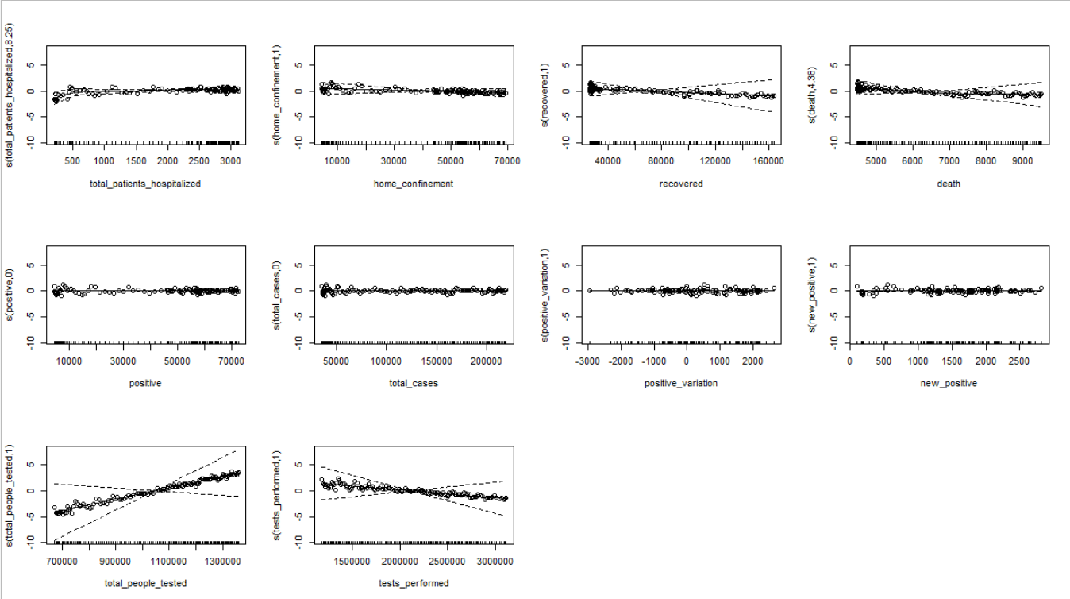
Model 1 – All variables included

Slide 10
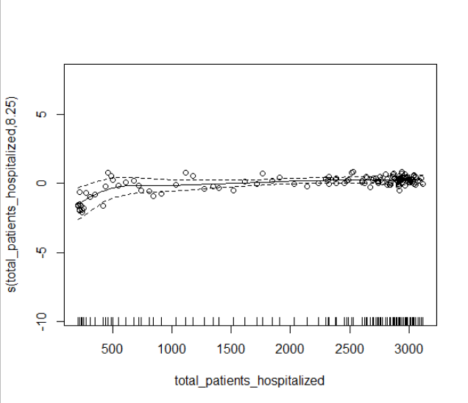
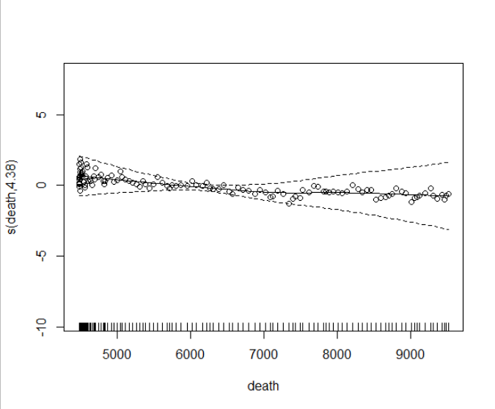
From these plots, we can conclude that the following variables should be smoothed: total_patients_hospitalized and death. Also, it was confirmed with an edf NOT equal to 1

Slide 11
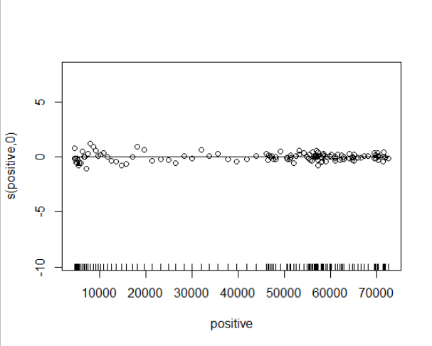
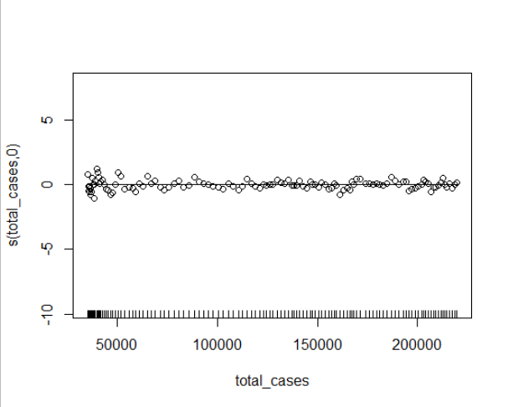
Whereas these variables are not significant: positive and total_cases

Slide 12
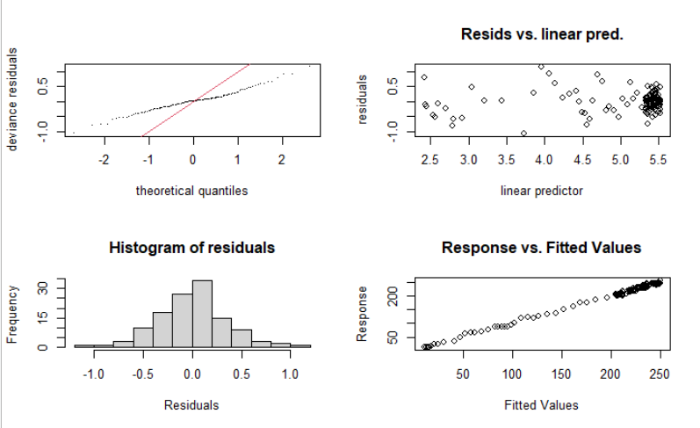
Model 1- Residual Plots

Slide 13
Model 1- output discussion
The QQ plot shows that the deviance residuals and theoretical residuals do not coincide.
However, we have an almost normal distribution for the residual histogram.
Residuals vs linear predictor shows that there is somehow an evenly distribution around 0
The response over fitted value nearly form a straight line.
AIC=904.0313 R-sq.(adj) = 0.997 Deviance explained = 99.7%.
The Root Mean Square Error(RMSE) of predicted values for patients in intensive care for 14 days compared to the actual values is 12.43594
For the next models, we linearize some variables and remove the least significant ones.

Slide 14
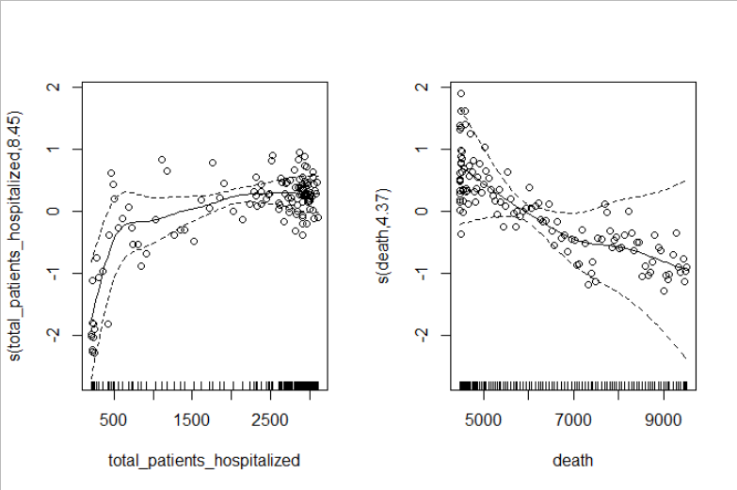
Model 2- Best model variables included: smooths of total_patients_hospitalized and death + linear terms of total_people_tested and tests_performed

Slide 15
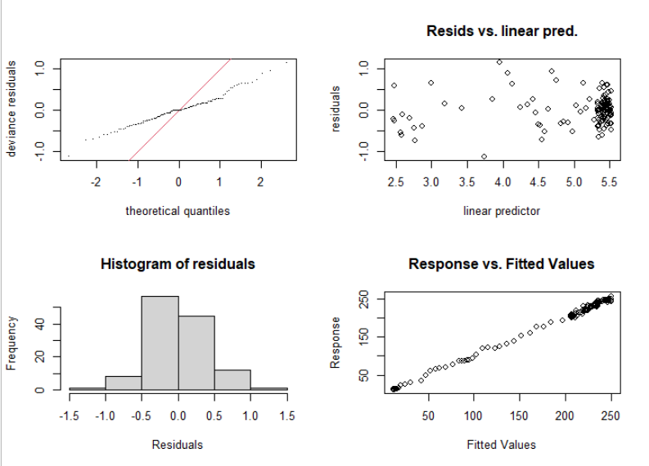
Model 2 – Residual Plots It does not show any enhancement than the previous model.

Slide 16
Model 2- output discussion
Although, the residual plots does not show any enhancement from the full model; the AIC for this model is lower than that of the full model. Also, when this model was used for prediction, it showed a lower root mean square error.
AIC=894.4661 R-sq.(adj) = 0.997 Deviance explained = 99.7%.
The Root Mean Square Error(RMSE) of predicted values for patients in intensive care for 14 days compared to the actual values is 9.85764

Slide 17
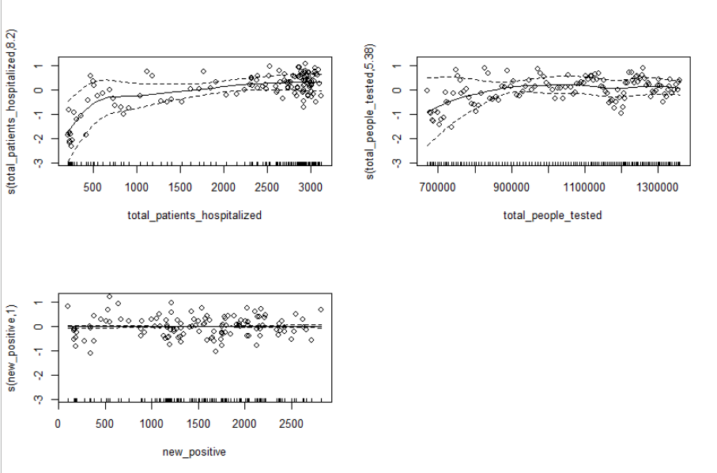
Model 3- including the 4 independent variables obtained using Pearson correlation coefficient
We can see that the variable new_positive does not need smoothing with edf =1
Color variable was not smoothed

Slide 18
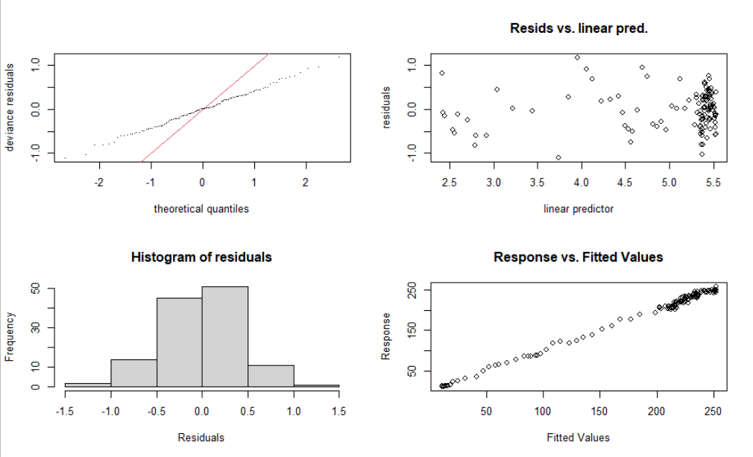
Model 3 – Residual Plots

Slide 19
Model 3- output discussion
The overall residuals does not show any improvement from the previous 2 models. The AIC is better than the full model, but worse than the best model obtained without considering Pearson coefficients.
AIC=903.475 R-sq.(adj) = 0.995 Deviance explained = 99.6%.
The Root Mean Square Error(RMSE) of predicted values for patients in intensive care for 14 days compared to the actual values is 3.4362299
We can get a new model by removing some least significant variables which is in this case: color and new_positive

Slide 20
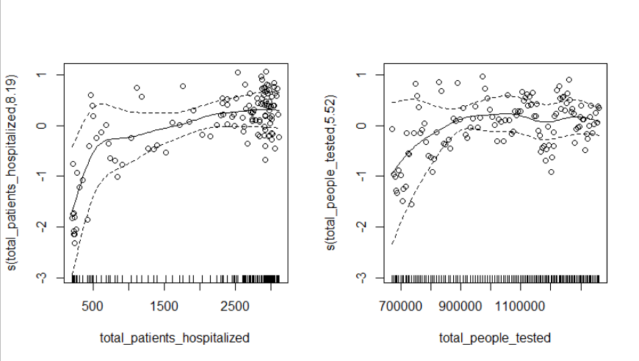
Model 4- Best Model considering Pearson Coefficients

Slide 21
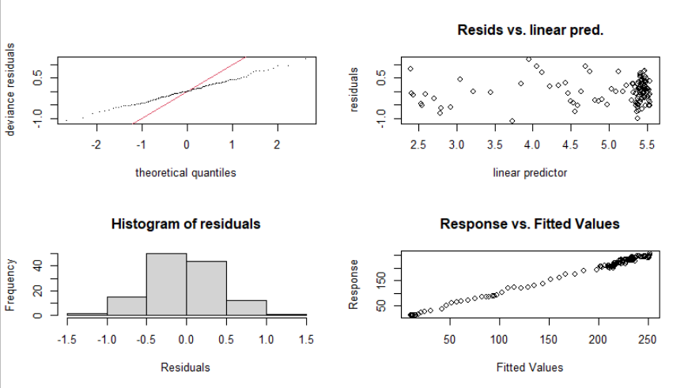
Model 4 – Residual Plots

Slide 22
Model 4- output discussion
The overall residuals show very little improvement compared to the third model. However, the AIC decreases.
AIC=899.7196 R-sq.(adj) = 0.995 Deviance explained = 99.6%.
The error of prediction decreases tremendously from all the previous models.
The Root Mean Square Error(RMSE) of predicted values for patients in intensive care for 14 days compared to the actual values is 3.73646199

Slide 23
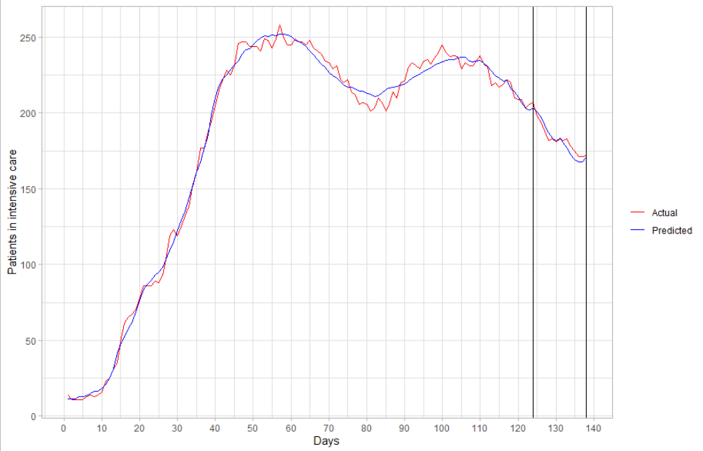
Actual vs. predicted for the best model

Slide 24
Best model vs. overfitted model
The best model we obtained has shown very good predicting performance, with a low root mean square error.
Graphing the actual vs. the predicted results shows that maybe there is high variance in our model. This could be causing an overfitting of our data. Thus, we are obtaining a “good” model.
Since we are solving such a critical problem related to the pandemic, the main goal is not producing a good model but rather a reliable one.
We could apply the same models and approaches on maybe a larger dataset and using validation techniques, like cross validation to get more robust models.

